Slide 1
DC Motors
Lecture 7

Slide 2
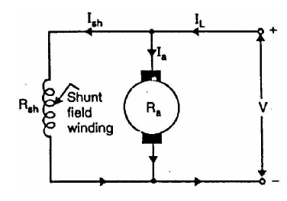
Types of D.C. Motors
Like generators, there are three types of d.c. motors characterized by the connections of field winding in relation to the armature
Shunt-wound motor in which the field winding is connected in parallel with the armature. The current through the shunt field winding is not the same as the armature current. Shunt field windings are designed to produce the necessary m.m.f. by means of a relatively large number of turns of wire having high resistance. Therefore, shunt field current is relatively small compared with the armature current.

Slide 3
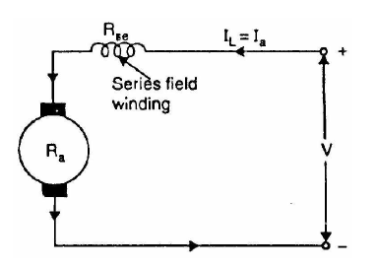
Series-wound motor in which the field winding is connected in series with the armature. Therefore, series field winding carries the armature current. Since the current passing through a series field winding is the same as the armature current, series field windings must be designed with much fewer turns than shunt field windings for the same m.m.f. Therefore, a series field winding has a relatively small number of turns of thick wire and, therefore, will possess a low resistance.

Slide 4
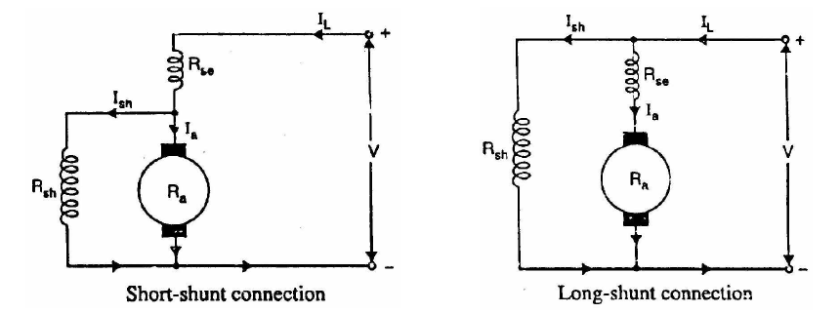
Compound-wound motor which has two field windings; one connected in parallel with the armature and the other in series with it. There are two types of compound motor connections (like generators). When the shunt field winding is directly connected across the armature terminals, it is called short-shunt connection. When the shunt winding is so connected that it shunts the series combination of armature and series field it is called long-shunt connection.

Slide 5
Applications of D.C. Motors
Shunt motors
The characteristics of a shunt motor reveal that it is an approximately constant speed motor. It is, therefore, used
(i) where the speed is required to remain almost constant from no-load to full-load
(ii) where the load has to be driven at a number of speeds and any one of which is required to remain nearly constant
Industrial use: Lathes, drills, boring mills, shapers, spinning machines etc.
Series motors
It is a variable speed motor i.e., speed is low at high torque and vice-versa.
However, at light or no-load, the motor tends to attain dangerously high speed.
The motor has a high starting torque. It is, therefore, used
(i) where large starting torque is required e.g., in elevators and electric traction
(ii) where the load is subjected to heavy fluctuations and the speed is automatically required to reduce at high torques and vice-versa.
Industrial use: Electric traction, cranes, elevators, air compressors, vacuum
cleaners, hair drier, sewing machines etc.

Slide 6
Examples :
1. A 250 V d.c shunt motor takes total current of 20 A. Resistance of shunt field winding is 200 ohm and that of armature is 0.3 ohm. What is the current in the armature?
What is the value of back emf ?
A 440 V shunt motor has an armature resistance of 0.8 ohm and a field resistance of 200 ohm. Find the back emf, when giving an output of 7.46kW at 85% efficiency?
A dc shunt motor takes 5 A at 100 V when running light. Shunt resistance is 50 ohm and armature resistance is 0.2 ohm. What is the driving power?
A 200 V dc series motor is taking a current of 40 A. Resistance of armature is 0.5 ohm and resistance of series field is 0.25 ohm. What is the voltage at the brushes? What is the value of back emf?

Slide 7
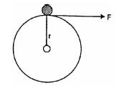
Armature Torque of D.C. Motor
Torque is the turning moment of a force about an axis and is measured by the product of force (F) and radius (r) at right angle to which the force acts i.e.D.C. Motors
T = F r
In a d.c. motor, each conductor is acted upon by a circumferential force F at a distance r, the radius of the armature (Fig. 4.8). Therefore, each conductor exerts a torque, tending to rotate the armature. The sum of the torques due to all armature conductors is known as gross or armature torque (Ta).
Let in a d.c. motor
r = average radius of armature in m
l = effective length of each conductor in m
Z = total number of armature conductors
A = number of parallel paths
i = current in each conductor = Ia/A
B = average flux density in Wb/m2
f = flux per pole in Wb
P = number of poles

Slide 8
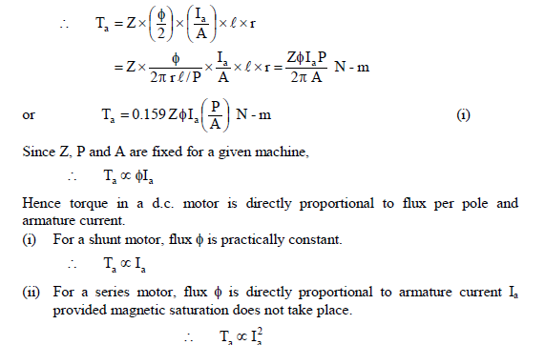
Force on each conductor, F = B i l newtons
Torque due to one conductor = F ´ r newton- metre
Total armature torque, Ta = Z F r newton-metre
= Z B i l r
Now i = Ia/A, B = Ø/a where a is the x-sectional area of flux path per pole at radius r. Clearly, a = 2πr l /P.

Slide 9
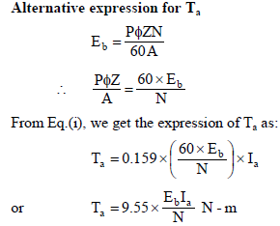
Example : A 220 V d.c shunt motor takes a total current of 80 A and runs at 800 r.p.m.
Resistance of shunt field winding is 50 ohm and that of armature is 0.1 ohm. What is the
Driving power of motor and the armature torque.

Slide 10
Shaft Torque (Tsh)
The torque which is available at the motor shaft for doing useful work is known as shaft torque. It is represented by Tsh. The total or gross torque Ta developed in the armature of a motor is not available at the shaft because a part of it is lost in overcoming the iron and frictional losses in the motor. Therefore, shaft torque Tsh is somewhat less than the armature torque Ta. The difference Ta - Tsh is called lost torque.
Lost torque =
Example : A 220 V d.c shunt motor takes a total current of 80 A and runs at 800 r.p.m.
Resistance of shunt field winding is 50 ohm and that of armature is 0.1 ohm. What is the
Driving power of motor and find armature torque ,lost torque and shaft torque.
A 240 V dc shunt motor takes a total current of 74 A and runs at 850 r.p.m. Armature resistance is 0.1 while shunt resistance is 55 ohm, find armature, lost and shaft torque ?

