Slide 1
DC Generators
Lecture 03

Slide 2
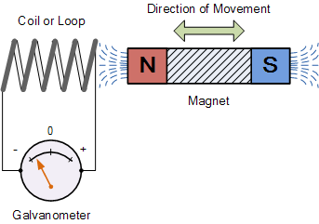
Electromagnetic Induction :
When the magnetic flux linking a conductor (or coil) changes an e.m.f is induced in the
conductor. If the conductor (or coil) forms a complete loop, a current will flow in it. This
phenomenon is called electromagnetic induction.
When the magnet shown below is moved
“towards” the coil, the pointer or needle of
the Galvanometer, which is basically a very
sensitive centre zeroed moving-coil ammeter,
will deflect away from its centre position in
one direction only. When the magnet stops
moving and is held stationary with regards to
the coil the needle of the galvanometer
returns back to zero as there is no physical movement of the magnetic field.

Slide 3
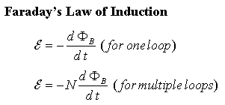
Faraday’s Law of Electromagnetic Induction
First Law : First Law of Faraday's Electromagnetic Induction state that whenever a conductor are placed in a varying magnetic field emf are induced which is called induced emf, if the conductor circuit are closed current are also induced which is called induced current.Or
Whenever a conductor is rotated in magnetic field emf is induced which are induced emf.
Second Law : The magnitude of the emf induced in a conductor or coil is directly proportional to
the rate of change of flux linkages.
If N is the number of turns of coils and the magnetic flux linking the coil changes from ϕ1 to ϕ2
in t seconds, then
The minus sign represents Lenz’s Law. In SI unit, e is measured in volts, ϕ in Webers and t in seconds
Lenz’s Law: The induced current will flow in such a direction so as to oppose the cause which
produce it.
Flux Linkage : The product of number of turns (N) of a coil and the magnetic flux (ϕ) linking
the coils is called flux linkage i.e Flux Linkage = N * ϕ
Magnitude of emf induced in a coil is directly proportional to the rate of change of flux linkage.

Slide 4
How much voltage (emf) can be induced into the coil using just magnetism.
This is determined by the following 3 different factors.
1). Increasing the number of turns of wire in the coil. – By increasing the amount of individual conductors cutting through the magnetic field, the amount of induced emf produced will be the sum of all the individual loops of the coil, so if there are 20 turns in the coil there will be 20 times more induced emf than in one piece of wire.
2). Increasing the speed of the relative motion between the coil and the magnet. – If the same coil of wire passed through the same magnetic field but its speed or velocity is increased, the wire will cut the lines of flux at a faster rate so more induced emf would be produced.
3). Increasing the strength of the magnetic field. – If the same coil of wire is moved at the same speed through a stronger magnetic field, there will be more emf produced because there are more lines of force to cut.

Slide 5
Generator Principle
An electric generator is a machine that converts mechanical energy in
to electrical energy. An electric generator based on the principle that
whenever flux is cut by a conductor, an e.m.f is induced which will
cause a current to flow if the conductor circuit is closed.
The essentials components of a generator are:
a magnetic filed
conductor or group of conductors
motion of conductor w.r.t magnetic filed.
The AMOUNT of voltage generated depends on:
the strength of the magnetic field,
the angle at which the conductor cuts the magnetic field,
the speed at which the conductor is moved, and
the length of the conductor within the magnetic field

Slide 6
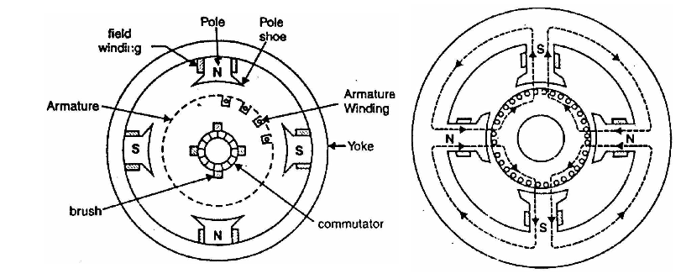
Construction of D.C. Generator
The d.c. generators and d.c. motors have the same general construction. In fact, when the machine is being assembled, the workmen usually do not know whether it is a d.c. generator or motor. Any d.c. generator can be run as a d.c. motor and vice-versa. All d.c. machines have five principal components viz., (i)field system (ii) armature core (iii) armature winding (iv) commutator (v) brushes

Slide 7
DC MACHINES
MAIN CONSTRUCTIONAL FEATURES
YOKE
ARMATURE
+
SHAFT
FIELD POLE
& COIL
BRUSH
-
COMMUTATOR

Slide 8
DC MACHINES
MAIN CONSTRUCTIONAL FEATURES
Bearing
Brush
Body / Yoke
Pulley
End Housing
Shaft
Armature
Commutator
Field Core
Brush
holder
Field Winding

Slide 9
(1) Field System : The function of the field system is to produce uniform magnetic field within which the armature rotates. It consists of a number of poles bolted to the inside of circular frame (generally called yoke).
MAGNETIC FRAME or YOKE The outer cylindrical frame to which main poles and inter poles are fixed and by means of the machine is fixed to the foundation is called YOKE.
It serves two purposes:
a) It provides mechanical protection to the inner parts of the machines.
b) It provides a low reluctance path for the magnetic flux.
POLE CORE AND POLE SHOES :The pole core and pole shoes are fixed to the yoke by bolts. They serves the following purpose :
They support the field or exciting coils.
They distribute the magnetic flux on the armature periphery more uniformly.

Slide 10
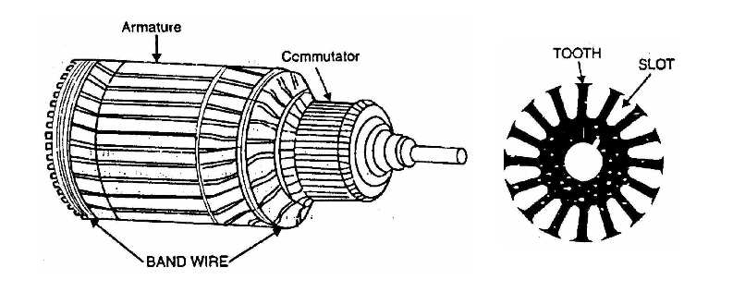
Field coils or exciting coils are used to magnetize the pole core. Enameled copper wire is used for the construction of these coils. When direct current is passed through these coils/ winding, it sets up the magnetic field which magnetize the pole core to the reqd. flux.
(ii) Armature core: The armature core is keyed to the machine shaft and rotates
between the field poles. The rotating armature cuts the main magnetic field ,
therefore an e.m.f is induced in the armature core..
Armature core serves the following purposes:
a) It houses the conductors in the slots.
b) It provides an easy path for magnetic flux

Slide 11
(iii) Armature winding: The slots of the armature core hold insulated
conductors that are connected in a suitable manner. This is known as armature
winding. This is the winding in which “working” e.m.f. is induced. The armature
conductors are connected in series-parallel; the conductors being connected in
series so as to increase the voltage and in parallel paths so as to increase the
current. The armature winding of a d.c. machine is a closed-circuit winding; the
conductors being connected in a symmetrical manner forming a closed loop or
series of closed loops

Slide 12
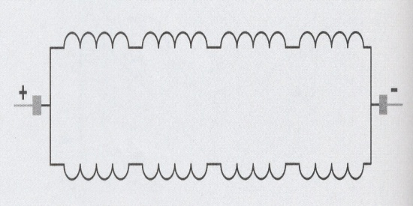
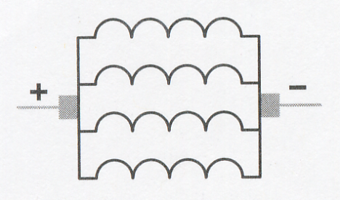
Depending upon the types of inter connection. of coils , the winding can be classified into two types;
Simple wave winding: In this arrangement , the armature coils are connected in series through commutator segments in such a way that the armature winding is divided into two parallel paths irrespective of the numbers of poles of the machine . If there are Z armature conductors , then Z/2 conductors will be in series in each parallel path as shown:
These are used in machines designed for high
voltage and low current.
No of current path, C=2
Simple Lap winding: : In this arrangement , the armature coils are connected in series through commutator segments in such a way that the armature winding is divided into as many parallel paths as the number of poles of the machine . If there are Z conductors and P poles then there will be P parallel paths each containing Z/P conductors in series .
-These are used in machines designed for low
voltage and high current.
-No of current path, C=2p ; p=no of poles

Slide 13
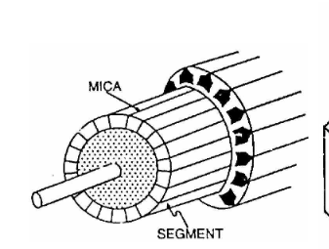
(iv) Commutator
A commutator is a mechanical rectifier which converts the alternating voltage generated in the armature winding into direct voltage across the brushes. The commutator is made of copper segments insulated from each other by mica sheets and mounted on the shaft of the machine. The armature conductors are soldered to the commutator segments in a suitable manner to give rise to the armature winding.

Slide 14
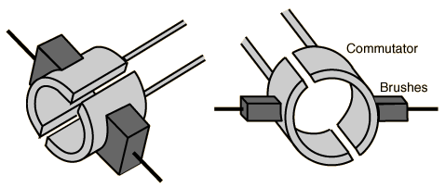
(v) Brushes:
The purpose of brushes is to ensure electrical connections between the rotating commutator and stationary external load circuit. The brushes are made of carbon and rest on the commutator. The brush pressure is adjusted by means of adjustable springs. If the brush pressure is very large, the friction produces heating of the commutator and the brushes. On the other hand, if it is too weak, the imperfect contact with the commutator may produce sparking.

Slide 15
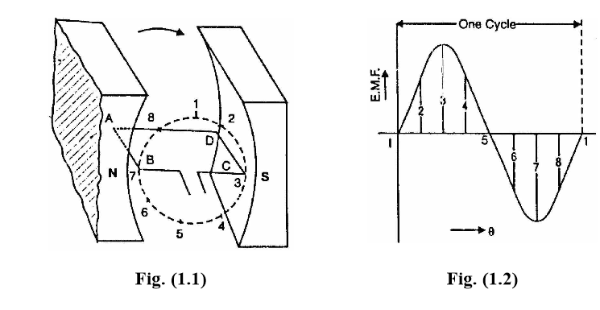
Simple Loop Generator
Consider a single turn loop ABCD rotating clockwise in a uniform magnetic field with a constant speed as shown in Fig.(1.1). As the loop rotates, the flux linking the coil sides AB and CD changes continuously. Hence the e.m.f. induced in these coil sides also change.
(i) When the loop is in position no. 1 [the generated e.m.f. is zero because the coil sides (AB and CD) are cutting no flux but are moving parallel to it,
(ii) When the loop is in position no. 2, the coil sides are moving at an angle to the flux and, therefore, a low e.m.f. is generated as indicated by point 2 in Fig. (1.2)

Slide 16
iii) When the loop is in position no. 3, the coil sides (AB and CD) are at right angle to the flux and are, therefore, cutting the flux at a maximum rate. Hence at this instant, the generated e.m.f. is maximum as indicated by point 3 in Fig. (1.2)
(iv) At position 4, the generated e.m.f. is less because the coil sides are cutting the flux at an angle.
(v) At position 5, no magnetic lines are cut and hence induced e.m.f. is zero as indicated by point 5 in Fig. (1.2).
(vi) At position 6, the coil sides move under a pole of opposite polarity and hence the direction of generated e.m.f. is reversed. The maximum e.m.f. in this direction (i.e., reverse direction, See Fig. 1.2) will be when the loop is at position 7 and zero when at position 1. This cycle repeats with each revolution of the coil

Slide 17
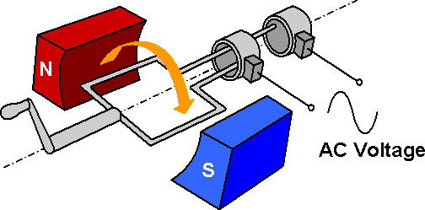

Slide 18
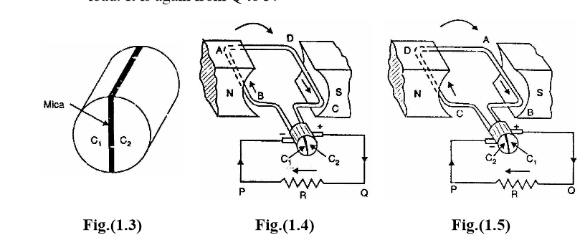
Action Of Commutator
The alternating voltage generated in the loop can be converted into direct voltage by a device called commutator.
(i) In Fig. (1.4), the coil sides AB and CD are under N-pole and S-pole respectively. Note that segment C1 connects the coil side AB to point P of the load resistance R and the segment C2
connects the coil side CD to point Q of the load. Also note the direction of current through load. It is from Q to P.

Slide 19
(ii) After half a revolution of the loop (i.e., 180° rotation), the coil side AB is under S-pole and the coil side CD under N-pole as shown in Fig. (1.5). The currents in the coil sides now flow in the reverse direction but the segments C1 and C2 have also moved through 180° i.e., segment C1
Is now in contact with +ve brush and segment C2 in contact with −ve brush.
Note that commutator has reversed the coil connections to the load i.e.,coil side AB is now connected to point Q of the load and coil side CD to the point P of the load. Also note the direction of current through the load. It is again from Q to P

Slide 20
MAGNETIC FIELD
A
B
ω
A
A
Q
P
B
LOAD
0º

Slide 21
MAGNETIC FIELD
A
B
ω
A
+
Q
P
_
B
e
LOAD
30º
ωt

Slide 22
MAGNETIC FIELD
A
B
ω
A
+
Q
P
_
B
e
LOAD
60º
ωt

Slide 23
MAGNETIC FIELD
A
B
ω
+
Q
A
B
P
_
e
LOAD
90º
ωt

Slide 24
MAGNETIC FIELD
A
B
ω
A
B
+
Q
P
A
_
e
LOAD
120º
ωt

Slide 25
MAGNETIC FIELD
B
A
ω
B
A
+
Q
P
_
A
e
LOAD
150º
ωt

Slide 26
MAGNETIC FIELD
B
A
ω
B
A
+
Q
P
A
e
LOAD
180º
ωt

Slide 27
MAGNETIC FIELD
B
A
ω
B
+
Q
P
_
A
e
LOAD
210º
ωt

Slide 28
MAGNETIC FIELD
B
A
ω
B
+
Q
P
_
A
e
LOAD
240º
ωt

Slide 29
MAGNETIC FIELD
B
A
ω
+
Q
B
A
P
_
e
LOAD
270º
ωt

Slide 30
MAGNETIC FIELD
B
A
ω
A
A
+
Q
P
B
_
e
LOAD
300º
ωt

Slide 31
MAGNETIC FIELD
A
B
ω
A
A
+
Q
P
_
B
e
LOAD
330º
ωt

Slide 32
MAGNETIC FIELD
A
B
ω
A
A
Q
P
B
e
LOAD
360º
ωt

Slide 33
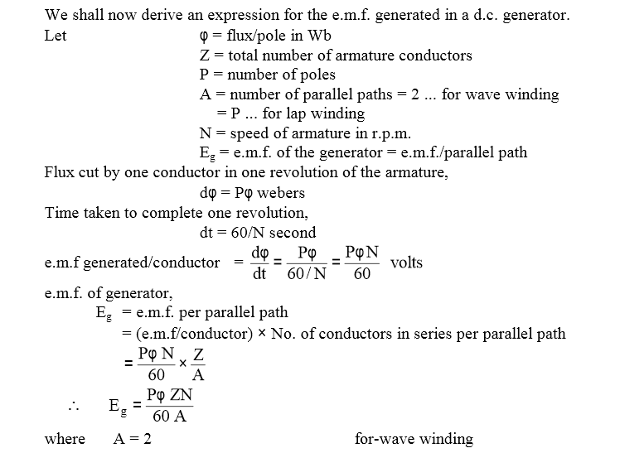

Slide 34
Examples :1 A 6-pole lap wound dc generator has 600 conductors on its armature.
The flux per pole is 0.02 wb. The speed at which the generator must be run to generator
300 V is?
Example :2: In the above question what should be speed of the generator if it is a wave
connected?
Example 3: A 4 pole dc machine with wave wound armature having 41 slots : each slot has 12
Conductors. The flux per pole is 25mWb. If the generator is driven at 1000rpm. What is
generated emf?
Hint Z=Q*n = Armature Conductors = no of slots * no of conductors in each slot.

