Slide 1
Lecture 10
DC Motors

Slide 2
Electric Braking
Sometimes it is desirable to stop a d.c. motor quickly. This may be necessary in case of emergency or to save time if the motor is being used for frequently repeated operations. The motor and its load may be brought to rest by using either (i) mechanical (friction) braking or (ii) electric braking. In mechanical braking, the motor is stopped due to the friction between the moving parts of the motor and the brake shoe i.e. kinetic energy of the motor is dissipated as heat. Mechanical braking has several disadvantages including non-smooth stop and greater stopping time.
In electric braking, the kinetic energy of the moving parts (i.e., motor) is converted into electrical energy which is dissipated in a resistance as heat or alternativley, it is returned to the supply source (Regenerative braking). For d.c. shunt as well as series motors, the following three methods of electric braking are used:
(i) Rheostatic or Dynamic braking
(ii) Plugging
(iii) Regenerative braking

Slide 3
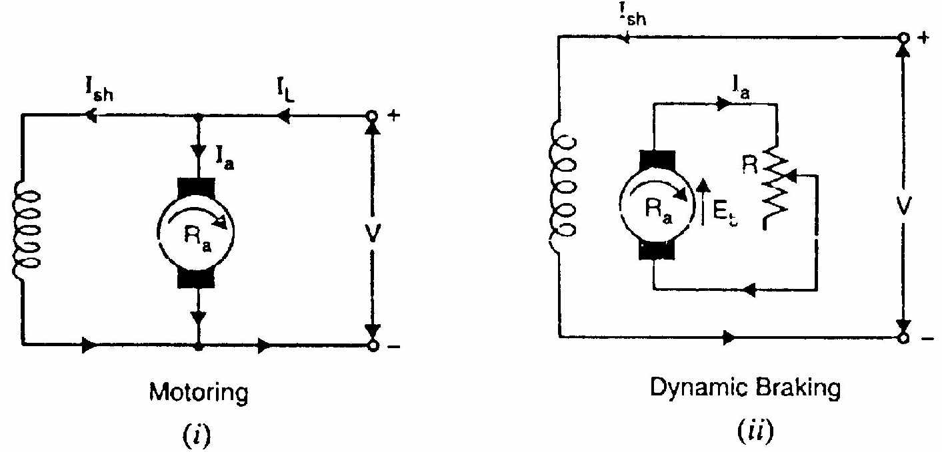
(i) Rheostatic or Dynamic braking:
In this method, the armature of the running motor is disconnected from the supply and is connected across a variable resistance R. However, the field winding is left connected to the supply. The armature, while slowing down, rotates in a strong magnetic field and, therefore, operates as a generator, sending a large current through resistance R. This causes the energy possessed by the rotating armature to be dissipated quickly as heat in the resistance. As a result,
the motor is brought to standstill quickly.

Slide 4
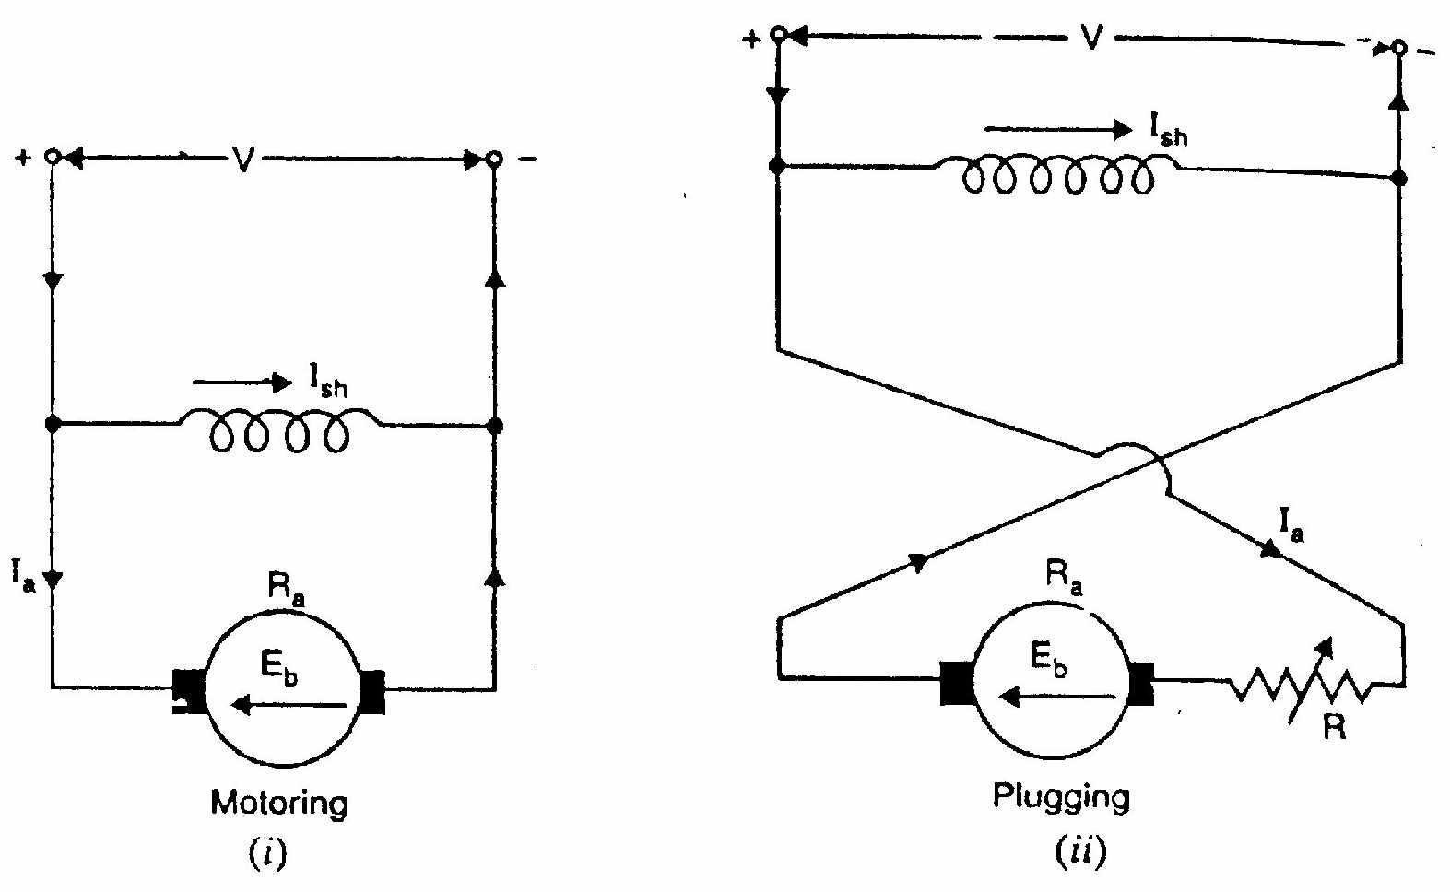
(ii) Plugging
In this method, connections to the armature are reversed so that motor tends to rotate in the opposite direction, thus providing the necessary braking effect. When the motor comes to rest, the supply must be cut off otherwise the motor will start rotating in the opposite direction.

Slide 5
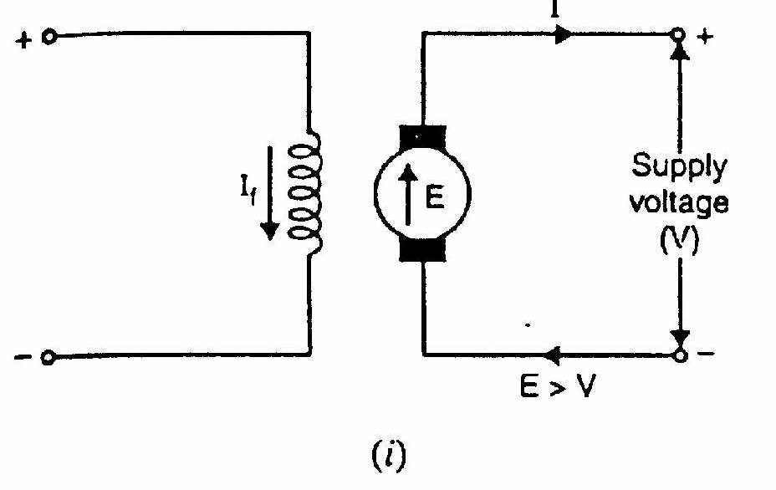
(iii) Regenerative braking:
In the regenerative braking, the motor is run as a generator. As a result, the kinetic energy of the motor is converted into electrical energy and returned to the supply. There are two methods of regenerative braking for a shunt motor.
(a) In one method, field winding is disconnected from the supply and field current is increased by exciting it from another source. As a result, induced e.m.f. E exceeds the supply voltage V and the machine feeds energy into the supply.

Slide 6
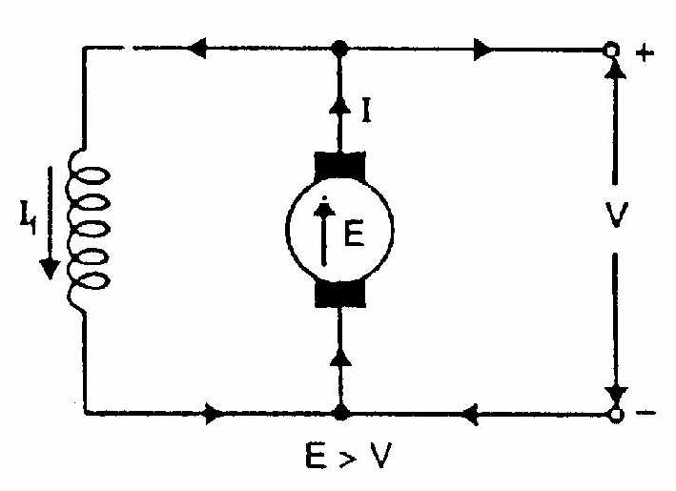
(b) In a second method, the field excitation does not change but the load causes the motor to run above the normal speed (e.g., descending load on a crane). As a result, the induced e.m.f. E becomes greater than the supply voltage V . The direction of armature current I, therefore, reverses but the direction of shunt field current If remains unaltered. Hence the torque is reversed and the speed falls until E becomes less than V.

Slide 7
Necessity of D.C. Motor Starter
At starting, when the motor is stationary, there is no back e.m.f. in the armature. Consequently, if the motor is directly switched on to the mains, the armature will draw a heavy current (Ia = V/Ra) because of small armature resistance. As an example, 5 H.P., 220 V shunt motor has a full-load current of 20 A and an armature resistance of about 0.5 W. If this motor is directly switched on to supply, it would take an armature current of 220/0.5 = 440 A which is 22 times the full-load current. This high starting current may result in:
(i) burning of armature due to excessive heating effect,
(ii) damaging the commutator and brushes due to heavy sparking,
(iii) excessive voltage drop in the line to which the motor is connected.
In order to avoid excessive current at starting, a variable resistance (known as starting resistance) is inserted in series with the armature circuit. This resistance is gradually reduced as the motor gains speed (and hence Eb increases) and eventually it is cut out completely when the motor has attained full speed. The value of starting resistance is generally such that starting current is limited to 1.25 to 2 times the full-load current.

