Slide 1
Speed Control of D.C. Motors
Lecture 9

Slide 2
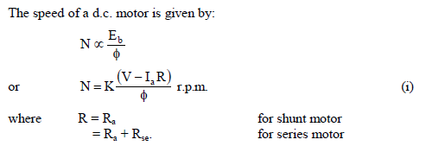
Introduction
Although a far greater percentage of electric motors in service are a.c. motors, the d.c. motor is of considerable industrial importance. The principal advantage of a d.c. motor is that its speed can be changed over a wide range by a variety of simple methods. Such a fine speed control is generally not possible with a.c. motors.
Speed Control of D.C. Motors
By varying the flux per pole (Ø). This is known as flux control method.
(ii) By varying the resistance in the armature circuit. This is known as armature control method.
(iii) By varying the applied voltage V. This is known as voltage control method.

Slide 3
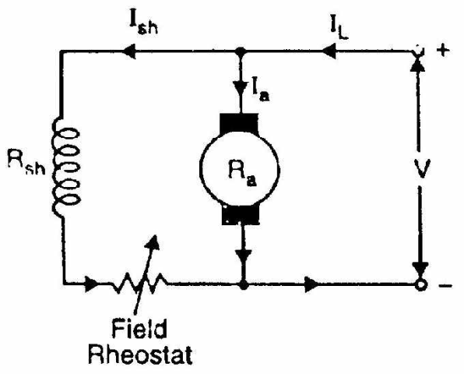
Speed Control of D.C. Shunt Motors
The speed of a shunt motor can be changed by (i) flux control method (ii) armature control method (iii) voltage control method. The first method (i.e. flux control method) is frequently used because it is simple and inexpensive.
Flux control method
It is based on the fact that by varying the flux Ø the motor speed (N = 1/Ø) can be changed and hence the name flux control method. In this method, a variable resistance (known as shunt field rheostat) is placed in series with shunt field winding as shown in Fig.
The shunt field rheostat reduces the shunt field current Ish and hence the flux . Therefore, we can only raise the speed of the motor above the normal speed.

Slide 4
Advantages
(i) This is an easy and convenient method.
(ii) It is an inexpensive method since very little power is wasted in the shunt field rheostat due to relatively small value of Ish.
(iii) The speed control exercised by this method is independent of load on the machine.
Disadvantages
(i) There is a limit to the maximum speed obtainable by this method. It is because if the flux is too much weakened, commutation becomes poorer.

Slide 5
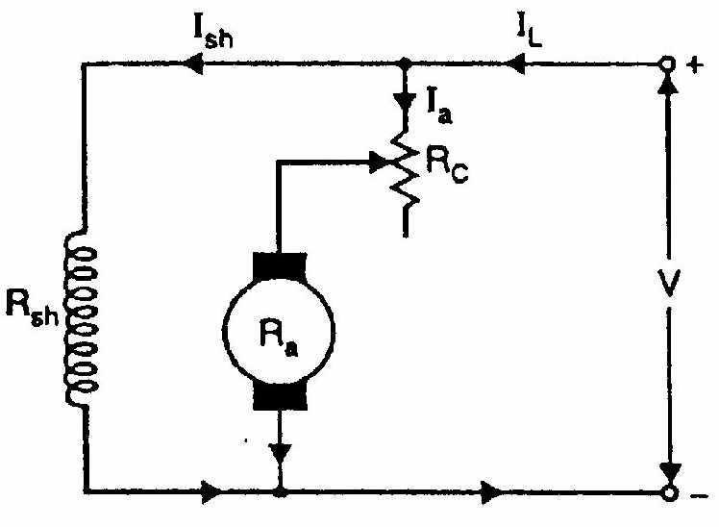
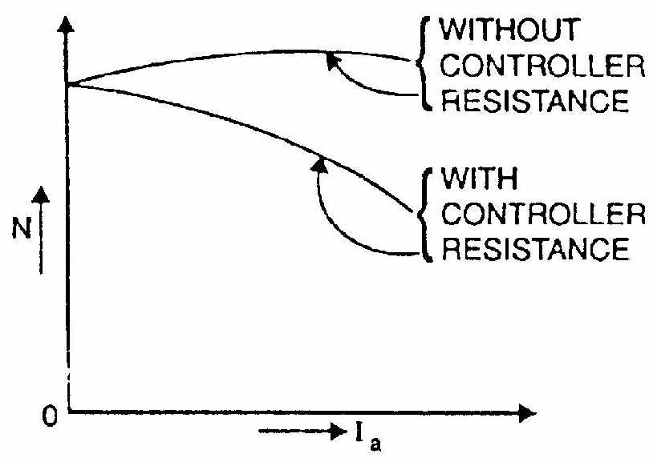
Armature control method
This method is based on the fact that by varying the voltage available across the armature, the back e.m.f and hence the speed of the motor can be changed. This is done by inserting a variable resistance RC (known as controller resistance) in series with the armature as shown in Fig.
N V - Ia (Ra + RC )
where RC = controller resistance

Slide 6
Due to voltage drop in the controller resistance, the back e.m.f. (Eb) is decreased. Since N Eb, the speed of the motor is reduced. The highest speed obtainable is corresponding to RC = 0 i.e., normal speed. Hence, this method can only provide speeds below then normal speed
Disadvantages
(i) A large amount of power is wasted in the controller resistance since it carries full armature current Ia.
(ii) The speed varies widely with load since the speed depends upon the voltage drop in the controller resistance and hence on the armature current demanded by the load.
(iii) The output and efficiency of the motor are reduced.
(iv) This method results in poor speed regulation.
Note. The armature control method is a very common method for the speed control of d.c. series

Slide 7
Voltage control method:
In this method, the voltage source supplying the field current is different from that which supplies the armature. This method avoids the disadvantages of poor speed regulation and low efficiency as in armature control method. However, it is quite expensive. Therefore, this method of speed control is employed for large size motors where efficiency is of great importance.
(i) Multiple voltage control. In this method, the shunt field of the motor is connected permanently across a-fixed voltage source. The armature can be connected across several different voltages through a suitable switchgear. In this way, voltage applied across the armature can be changed. The speed will be approximately proportional to the voltage applied across the armature. Intermediate speeds can be obtained by means of a shunt field
regulator.

Slide 8
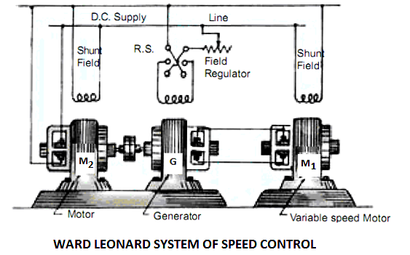
Ward-Leonard System:
This system is used where an unusually wide and very sensitive speed control is required as for colliery winders, electric excavators, elevators and the main drives in steel mills and blooming and paper mills. M1 is the main motor whose speed control is required. The field of this motor is permanently connected across the dc supply lines. By applying a variable voltage across its armature, any desired speed can be obtained. This variable voltage is supplied by a motor-generator set which consists of either a dc or an ac motor M2 directly coupled to generator G. The motor M2 runs at an approximately constant speed. The output voltage of G is directly fed to the main motor M1. The voltage of the generator can be varied from zero up to its maximum value by means of its field regulator. By reversing the direction of the field current of G by means of the reversing switch RS, generated voltage can be reversed and hence the direction of rotation of M1. It should be remembered that motor generator set always runs in the same direction..

Slide 10
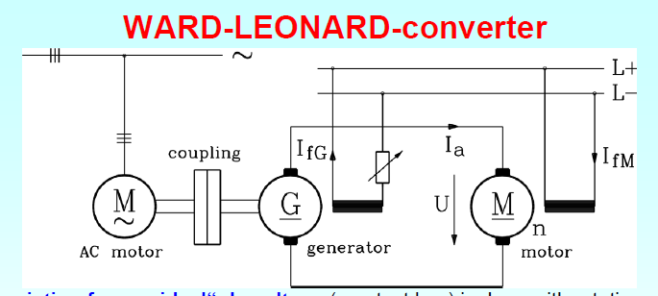
Advantages of Ward Leonard System
It is a very smooth speed control system over a very wide range (from zero to normal speed of the motor).
The speed can be controlled in both the direction of rotation of the motor easily.
Speed regulation of DC motor in this ward Leonard system is very good.
Disadvantages of Ward Leonard System
The system is very costly because two extra machines (motor-generator set) are required.
Overall efficiency of the system is low.

Slide 11
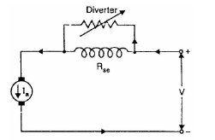
Speed Control of D.C. Series Motors
The speed control of d.c. series motors can be obtained by (i) flux control method (ii) armature-resistance control method. The latter method is mostly used.
1. Flux control method
In this method, the flux produced by the series motor is varied and hence the speed. The variation of flux can be achieved in the following ways
(i) Field divertcrs. In this method, a variable resistance (called field diverter) is connected in parallel with series field winding as shown in Fig. Its effect is to shunt some portion of the line current from the series field winding, thus weakening the field and increasing the speed.

Slide 12
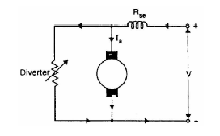
Armature diverter. In order to obtain speeds below the normal speed, a variable resistance (called armature diverter) is connected in parallel with the armature as shown in Fig. The diverter shunts some of the line current, thus reducing the armature current. Now for a given load, if Ia is decreased, the flux must increase the motor
speed is decreased. By adjusting the armature diverter, any speed lower than the normal speed can be obtained.

Slide 13
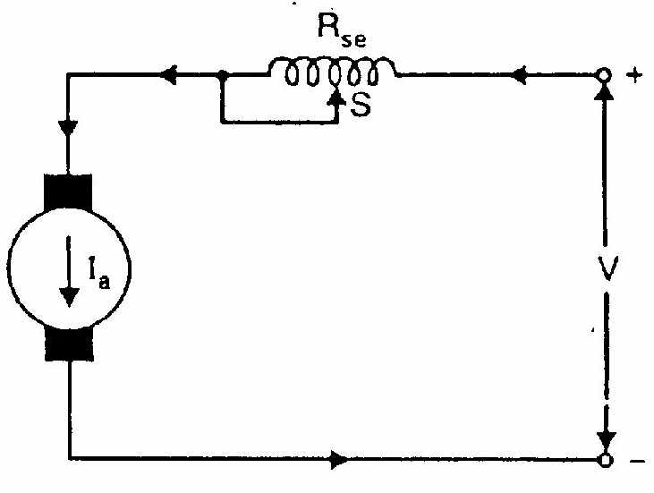
Tapped field control. In this method, the flux is reduced (and hence speed is increased) by decreasing the number of turns of the series field winding as shown in Fig. The switch S can short circuit any part of the field winding, thus decreasing the flux and raising the speed. With full turns of the field winding, the motor runs at normal speed and as the field turns are
cut out, speeds higher than normal speed are achieved.

Slide 14
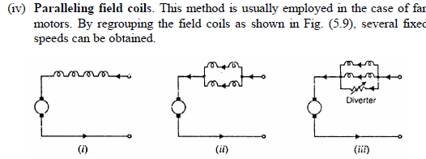

Slide 15
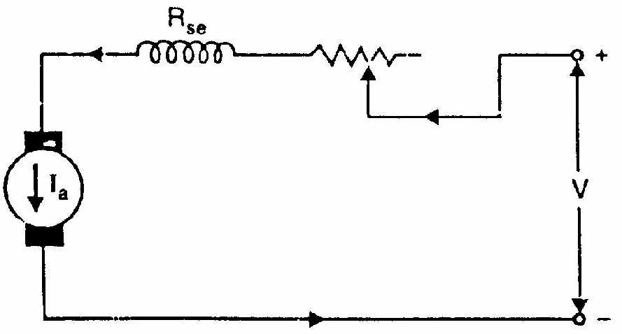
Armature-resistance control
In this method, a variable resistance is directly connected in series with the supply to the complete motor as shown in Fig. This reduces the voltage available across the armature and hence the speed falls. By changing the value of variable resistance, any speed below the normal speed can be obtained. This is the most common method employed to control the speed of d.c. series motors.

